Slide 1
Respiration in bacteria
Respiration, Fermentation and photosynthesis

Slide 2
Definition
Metabolism refers to all the biochemical reactions that occur in a cell or organism. The study of bacterial metabolism focuses on the chemical diversity of substrate oxidations and dissimilation reactions (reactions by which substrate molecules are broken down), which normally function in bacteria to generate energy.
Heterotrophic Metabolism
Heterotrophic metabolism is the biologic oxidation of organic compounds, such as glucose, to yield ATP and simpler organic (or inorganic) compounds, which are needed by the bacterial cell for biosynthetic or assimilatory reactions.e.g
Respiration
Fermentation
Photosynthesis

Slide 3
Respiration in Bacteria
Respiration
Respiration is a type of heterotrophic metabolism that uses oxygen and in which 38 moles of ATP are derived from the oxidation of 1 mole of glucose, yielding 380,000 cal. (An additional 308,000 cal is lost as heat.)
Complex process accompanied with liberation of energy required by microbes for synthesis of organic compunds.(Fermentation is the energy liberation process without participation of oxygen.

Slide 4
Types of bacteria with reference respiration
Obligate aerobes
Obligate anaerobes
Facultative anaerobes
Micro aerophilic bacteria

Slide 5
Glycolysis
Kreb’s Cycle/ fermentation
Electron transport Chain

Slide 6
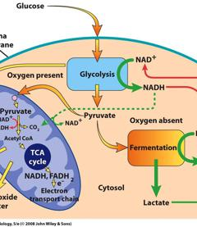
I-GLYCOLYSIS
https://tinycards.duolingo.com/decks/Jn7feuc4/respiration

Slide 7
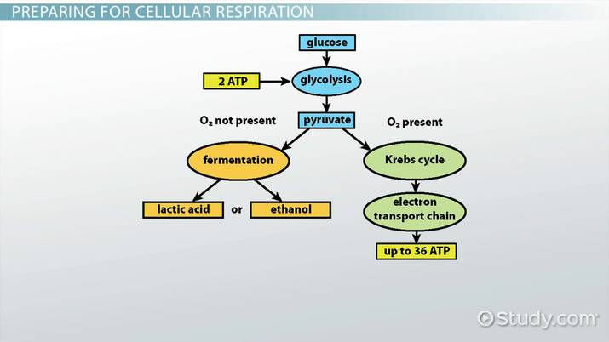

Slide 8
Glycolysis is a series of reactions that extract energy from glucose by splitting it into two three-carbon molecules called pyruvates.
Overall, glycolysis converts one six-carbon molecule of glucose into two three-carbon molecules of pyruvate. The net products of this process are two molecules of ATP and two molecules of NADH.
In organisms that perform cellular respiration, glycolysis is the first stage of this process. However, glycolysis doesn’t require oxygen, and many anaerobic organisms—organisms that do not use oxygen—also have this pathway.

Slide 9
Glycolysis takes place in the cytosol of a cell
two main phases: the energy-requiring phase and the energy-releasing phase.
Energy-requiring phase. In this phase, the starting molecule of glucose gets rearranged, and two phosphate groups are attached to it. The phosphate groups make the modified sugar—now called fructose-1,6-bisphosphate—unstable . The most important enzyme for regulation of glycolysis is phosphofructokinase, allowing it to split in half and form two phosphate-bearing three-carbon sugars. Because the phosphates used in these steps come from ATP (2 ATPs are used up).

Slide 10
The three-carbon sugars formed when the unstable sugar breaks down are different from each other. Only one—glyceraldehyde-3-phosphate—can enter the following step. However, the unfavorable DHAP can be easily converted into the favorable one, so both finish the pathway in the end

Slide 11
Step 1. A phosphate group is transferred from ATP to glucose, making glucose-6-phosphate. Glucose-6-phosphate is more reactive than glucose, and the addition of the phosphate also traps glucose inside the cell since glucose with a phosphate can’t readily cross the membrane.

Slide 12
Step 2. Glucose-6-phosphate is converted into its isomer, fructose-6-phosphate.
Step 3. A phosphate group is transferred from ATP to fructose-6-phosphate, producing fructose-1,6-bisphosphate. This step is catalyzed by tphosphofructokinase, which can be regulated to speed up or slow down the glycolysis pathway.

Slide 13
Step 4. Fructose-1,6-bisphosphate splits to form two three-carbon sugars: dihydroxyacetone phosphate DHAP and glyceraldehyde-3-phosphate. They are isomers of each other, but only one—glyceraldehyde-3-phosphate—can directly continue through the next steps of glycolysis.
Step 5. DHAP is converted into glyceraldehyde-3-phosphate. The two molecules exist in equilibrium, but the equilibrium is “pulled” strongly downward, as glyceraldehyde-3-phosphate is used up. Thus, all DHAP is eventually converted.

Slide 14
Energy-releasing phase. In this phase, each three-carbon sugar is converted into another three-carbon molecule, pyruvate, through a series of reactions. In these reactions, two ATP molecules and one NADH molecule are made. Because this phase takes place twice, once for each of the two three-carbon sugars, it makes four ATPs and two NADH.

Slide 15
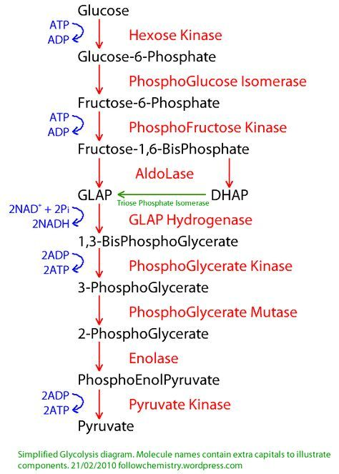
Glycolysis

Slide 16
Step 6. Two half reactions occur simultaneously:
1) Glyceraldehyde-3-phosphate (one of the three-carbon sugars formed in the initial phase) is oxidized.
2) NAD is reduced to NADH and H.The overall reaction is exergonic, releasing energy that is then used to phosphorylate the molecule, forming 1,3-bisphosphoglycerate.
Step 7. 1,3-bisphosphoglycerate donates one of its phosphate groups ADP and ATP is produced and turning into 3-phosphoglycerate in the process.
Step 8. 3-phosphoglycerate is converted into its isomer, 2-phosphoglycerate.

Slide 17
Step 9. 2-phosphoglycerate loses a molecule of water, becoming phosphoenolpyruvate(PEP), an unstable molecule, lose its phosphate group in the final step of glycolysis.
Step 10. PEP readily donates its phosphate group to ADP ,making a second molecule ATP. As it loses its phosphate,PEP is converted to pyruvate, the end product of glycolysis.

Slide 18
Medical Microbiology. 4th edition. Baron S, editor. Galveston (TX): University of Texas Medical Branch at Galveston; 1996. Chapter 4Bacterial Metabolism Peter Jurtshuk, Jr.

